Slide 1
PROJECT TITLE The Digital Network for Verified Property Transactions
CSE7301 Capstone Project
Batch Number: ISE-02
Roll Number | Student Name
20211ISE0014 | Abdul Majeed
20211ISE0019 | Pruthvi Bhat
20211ISE0037 | Hatti Vishnu
Under the Supervision of,
Prof. G.Shanmugarathinam
Associate Professor
School of Computer Science and Engineering
Presidency University

Slide 2
Introduction
The Indian real estate sector, driven by urban growth and increasing demand, continues to struggle with long-standing challenges such as lack of transparency, bureaucratic delays, and fraudulent transactions. Traditional systems are often manual and involve multiple intermediaries, leading to inefficiencies and mistrust among stakeholders. Current online platforms, though useful for listing and searching properties, do not adequately address issues related to document verification and secure transaction handling.
A significant problem in the market is the widespread occurrence of property document forgery and misrepresentation. Buyers frequently encounter inaccurate listings or incomplete ownership records, which can result in legal complications and financial losses. The absence of verified and accessible property data makes it difficult to confirm the legitimacy of listings, while fragmented systems force users to navigate multiple platforms for different steps of the transaction, increasing confusion and the risk of errors.
To address these issues, the proposed project aims to develop a secure and user-friendly digital platform that streamlines the property transaction process. This platform will allow users to list and search for properties while integrating government APIs to verify property documents and ownership in real-time. By consolidating key services such as listing, search, and document verification into a single interface, the system enhances transparency, reduces fraud, and simplifies property transactions for all parties involved.

Slide 3
Literature Review
Existing Methods
Centralized Government Portals :
Several countries use centralized portals for property registration (e.g., India’s Bhoomi, UK's Land Registry).
e-Governance Property Databases :
Systems like Singapore’s IRAS centralize property data across departments to improve access and coordination but still depend on centralized control.

Slide 4
Literature Review
Advantages of existing methods:
Legal recognition
Regulatory oversight
Standardized procedures
Online accessibility
Centralized data management
Disadvantages of existing methods:
Single point of failure
Risk of corruption
Manual verification delays
Limited transparency
Poor interoperability

Slide 5
Proposed Method
5.1 Full-Stack Architecture
Overview: A responsive web platform built with Next.js, integrating decentralized storage and smart contracts. Features:
Tailwind CSS for custom, scalable UI styling
MetaMask-enabled authentication and Ethereum smart contract integration
5.2 Government Verification
Overview: Simulates or integrates with official APIs to validate property documents. Features:
Admin dashboard for manual verification if API is unavailable
Supports dynamic integration with government systems
5.3 Data Flow Diagram
Overview: Shows the end-to-end flow of document verification and storage. Features:
Documents stored on IPFS with hash recorded in smart contracts
Real-time verification status displayed on the frontend

Slide 6
Objectives
Simplified Property Transactions: The platform streamlines the buying, selling, and renting process by automating tasks like document
handling, payments, and verification to reduce delays and errors.
Verified, Trustworthy Data Access: Buyers and sellers benefit from access to accurate, up-to-date property information, reducing fraud and
building confidence in listings.
Advanced Tools for All Users: Features like powerful search filters, real-time updates, listing management, and communication tools
enhance the experience for buyers, sellers, and agents alike.
AI-Driven Insights and Efficiency: Real estate agents can utilize data analytics and AI-powered recommendations to improve client service
and match properties more effectively.
Secure and Scalable Platform: The system ensures user security through encryption and verification while aiming for broad adoption
across India, including rural and urban markets.

Slide 7
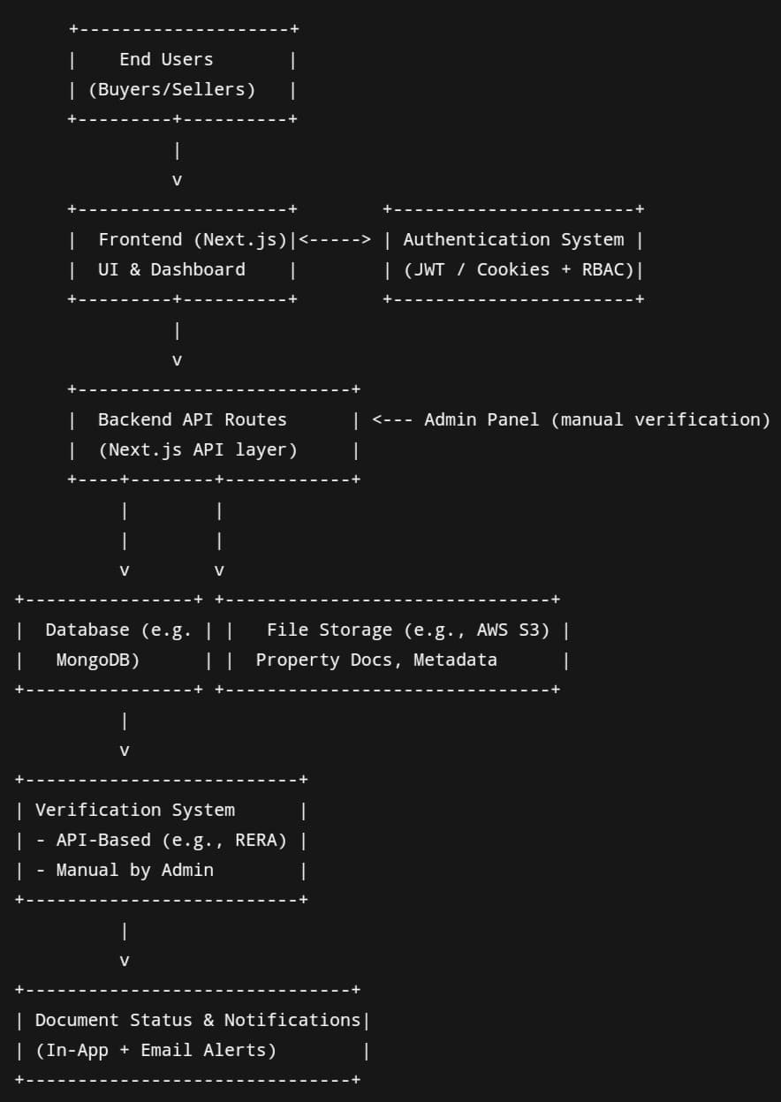
Methodology

Slide 8
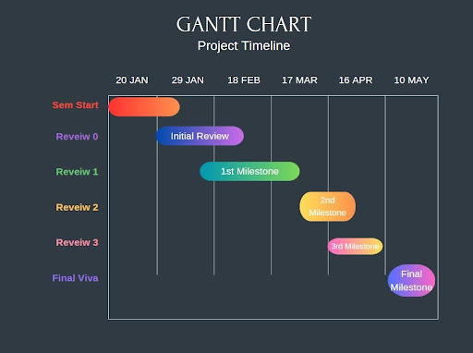
Timeline of Project

Slide 9
Expected Outcomes
Increased Transparency
Simplified Transactions
Enhanced Security
Faster Transactions
Greater Reach for Sellers
Improved Buyer Experience
Operational Efficiency for Agents
Growth and Scalability

Slide 10
Conclusion
Integration with government-backed property registration ensures legitimate, verified
properties, reducing fraud and misrepresentation.
Automation of processes like document submission and payment processing speeds up
transactions and reduces human error.
Advanced search tools empower buyers to make informed decisions, while sellers gain
greater exposure and easy listing management.
Agents benefit from real-time property updates, client communication systems, and
access to market analytics.
The platform integrates multiple services, reducing fragmentation and improving
overall market cohesion.
By modernizing and simplifying transactions, the platform will drive growth, reduce
fraud, and enhance the efficiency of India’s real estate sector.

Slide 11
References
Real Estate Regulatory Authority (RERA). (2022). Challenges in the Indian Real Estate Market: Transparency and Consumer Protection. Retrieved from www.rera.gov.in
This report discusses transparency issues and fraud within the real estate market in India.
India Today. (2023). Real Estate Frauds: How Buyers Are Being Misled. India Today. Retrieved from www.indiatoday.in
This article provides insight into how property buyers face challenges with fraud and misinformation in property transactions in India.
TechCrunch. (2022). Fragmented Platforms: How Real Estate Tech Struggles to Connect Buyers and Sellers. Retrieved from www.techcrunch.com
This article discusses how current platforms in the real estate market fail to provide a seamless experience for both buyers and sellers.
Journal of Real Estate Technology. (2021). The Role of AI and Blockchain in Transforming Real Estate Transactions. Journal of Real Estate Technology, 8(3), 57-74.
This study discusses the integration of AI and blockchain technologies in improving transparency and security in global real estate markets.
MagicBricks. (2022). State of the Indian Real Estate Market: Trends and Challenges. Retrieved from www.magicbricks.com
This report highlights the issues and trends in the Indian real estate market and the shortcomings of existing platforms.
Blockchain in Real Estate: The Future of Property Transactions. (2020). Harvard Business Review. Retrieved from www.hbr.org
This article discusses how blockchain technology is being explored to ensure transparency in real estate transactions.
Real Estate Times. (2022). Understanding the Regulatory Environment in India: The Impact of RERA on Property Transactions. Retrieved from www.realestatetimes.in
Provides an overview of how RERA has impacted the regulatory framework in India and the increased need for transparent, trustworthy real estate data.

Slide 12
References
Additional References of Project:
Government of India - Ministry of Housing and Urban Affairs. (2023). Housing for All: Policies and Initiatives. Retrieved from www.mohua.gov.in
Government publication discussing housing policies and reforms that impact real estate transactions.
KPMG. (2021). Digital Transformation in the Real Estate Sector: Opportunities and Challenges. KPMG Report. Retrieved from www.kpmg.com
A report on how the real estate sector is evolving through technology, with a focus on the digitalization of property transactions.

Slide 13
.
Thank You

